Slide 1







Department of
Computer Science and Information Technology
Minor project 2023
Submitted by:
Submitted to and
Guided by:
Parva Jain
Janhvi Kausal
Harshita Kukreja
Prof.Nidhi Nigam

Slide 2



Introduction
Problem Statement
Solution
Existing Apps
Our Features
Flow Chart
Conclusions
Keep in touch
Contents

Slide 3

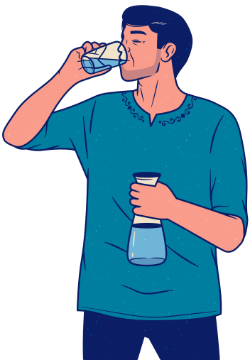

Problem Statement
Provider: Addressing the challenge of ensuring the consistent delivery of potable and uncontaminated water to every residential and commercial location.
Consumer: Ensuring prompt, high-purity, reliable, and customized water supply, meeting individualized specifications and satisfaction levels.

Slide 4
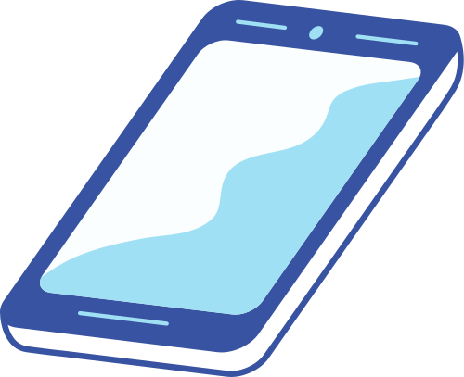
Solution
Create a comprehensive application for local water suppliers, facilitating record management, water distribution to various entities, and user-specific orders.For users to have hassle free ordering

Slide 5



existing software
Go paani :It has great interface but it asks for subcription to create an account which is not bearable to all local vendors
Pure Pani :it is similar to go pani but it doest allow tracking and scheduling facility
Jalam : it sale packaged drinking water of brands(bisleri,kinley,patanjali etc.)
Note: Many other only sell packaged drinking water but we are targeting local vendors not brands

Slide 6

Our Features
SCHEDULING FACILITY
ON TIME DELIVERY
REAL TIME UPDATES
PURITY ASSURANCE
FULFILLING THE SPECIFIC REQUIREMENTS OF USER
USER CAN EASIELY CONNECT TO PROVIDER (FEEDBACK)
RECORD MANAGEMENT
NO COST FOR USING.
FAST BILLING

Slide 7
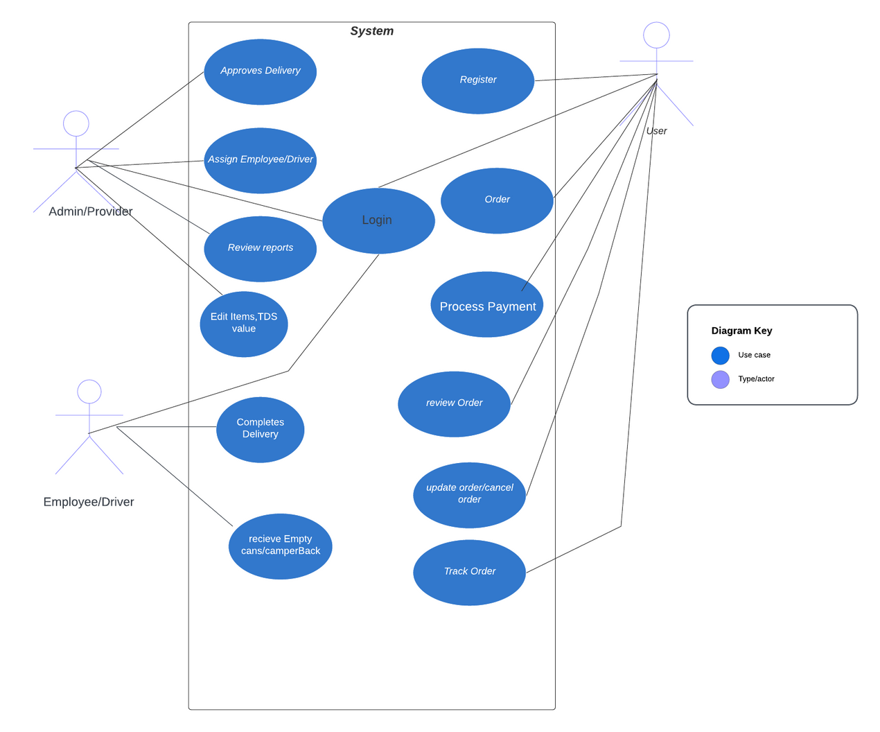
Use Case Diagram

Slide 8

Designing Includes
1. Splash Screen:
Display your app's logo and name while the app loads.
2. Onboarding:
Introduce new users to the app's features and benefits. Include a brief tutorial on how to use the app.
3. Sign Up / Log In:
Allow users to create accounts or log in using email, phone number, or social media credentials.

Slide 9
Designing Includes
4. Home Screen:
Provide a clear overview of the app's main features:
- Search and Filters: Enable users to search for water products by type (bottled, mineral, purified, etc.) and size (1L, 5L, etc.).
- Featured Products: Display special offers or popular products.
- Categories: Categorize water products based on brands or types.
5. Product Listings:
Display water products with details such as name, image, price, and quantity. Include an "Add to Cart" button for each product.

Slide 10
Designing Includes
6. Cart:
Show a summary of items in the user's cart. Allow users to update quantities or remove items. Display the total cost and a "Proceed to Checkout" button.
7. Checkout:
Gather delivery details, including the delivery address, preferred delivery time, and payment information. Provide different payment options, such as credit/debit cards, digital wallets, or cash on delivery.
8. Order Tracking:
Allow users to track the status of their orders in real-time. Provide updates from order placement to delivery.

Slide 11
Designing Includes
9. User Profile:
Enable users to manage their account information, including addresses, contact details, and payment methods.
10. Settings:
Provide options to customize app preferences, notifications, and language settings.
11. Contact and Support:
Include a section for users to contact customer support, ask questions, or provide feedback.

Slide 12


Technology Used :Front End
Flutter is an open source framework developed and supported by Google. Frontend and full-stack developers use Flutter to build an application's user interface (UI) for multiple platforms with a single codebase.

Slide 13

Technology Used :BackEnd
Firebase is a set of backend cloud computing services and application development platforms provided by Google. It hosts databases, services, authentication, and integration for a variety of applications, including Android, iOS, JavaScript, Node.js, Java, Unity, PHP, and C++.

Slide 14
Conclusion
In conclusion, the proposed application represents a powerful solution that addresses the multifaceted needs of local water suppliers and consumers alike.
By streamlining record management, enhancing water distribution efficiency, and providing user-friendly features such as order customization, tracking, and seamless billing and payment processing, this application has the potential to greatly improve the overall water supply ecosystem.
Its intuitive interface ensures a smooth user experience, making it a valuable tool for enhancing the accessibility and reliability of water services for a diverse range of stakeholders, from institutions and government facilities to households and event organizers.

Slide 15
Abstract
Water is an essential element of life and only 3% of fresh water is available on Earth out of which only 1% is drinkable, the other is in the form of glaciers, icebergs etc.
Most people depend on Tap water, wells and rivers for daily usage, but today around 70% of sewage in India is discharged into rivers, which contaminate groundwater, Sometime water pipeline to our home gets broken and sewage water gets merged into it and untreated waste is directly dumped into water bodies which cause pollution, and by drinking that water around 1 out of 5 people suffer from disease.

Slide 16
Abstract
People use Alum to purify water but some microbes are still present. People also can't afford a water purifier at every home as it has a huge installation cost and maintenance. People use to call local water vendors to meet their water need, which also Sometime do not provide purity assurance, on time delivery, Scheduling and trackability, So with growing digital india,we are designing a application for local water vendor which allow their user to order digitally and provide safety checks to assure purity, overcome all mentioned problem and provide ease of life.

Slide 17
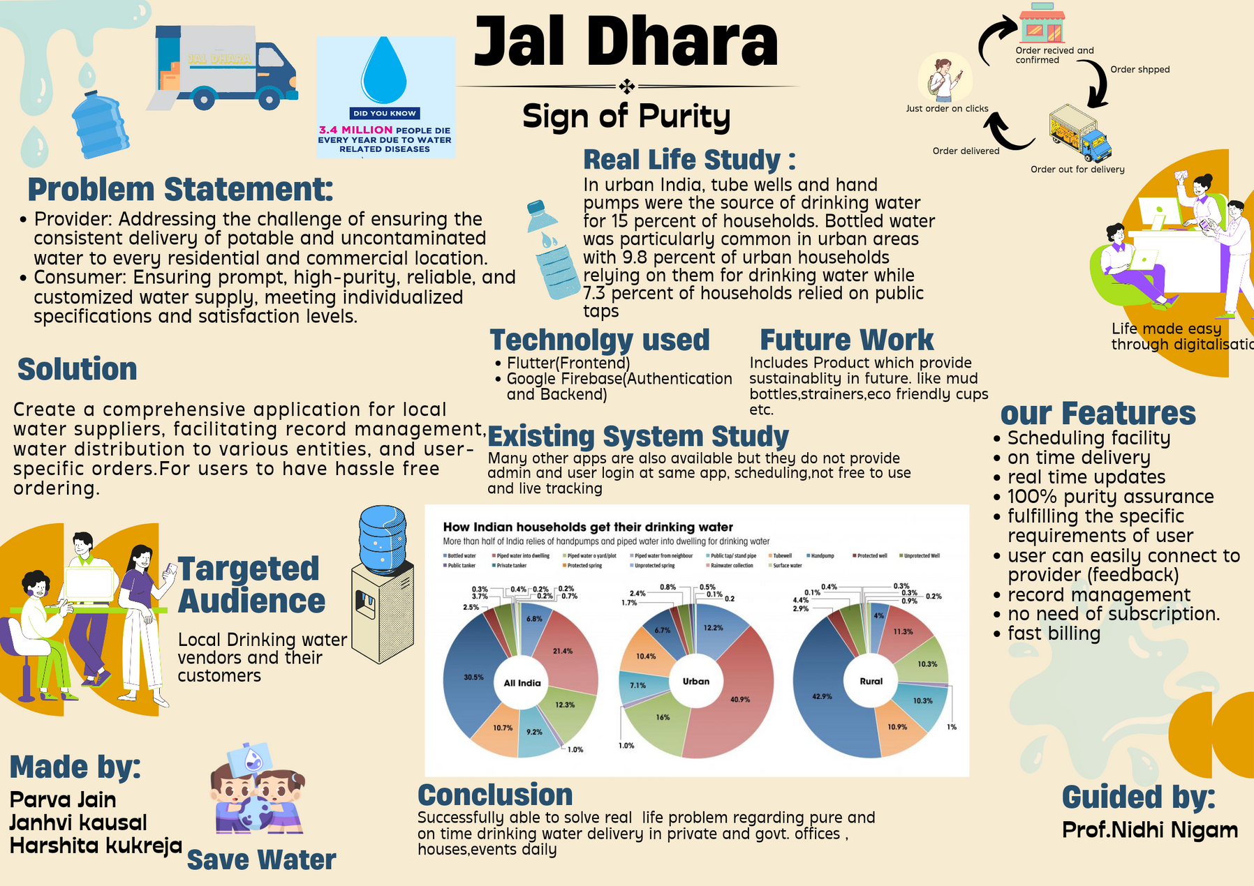

Slide 18
Useful Links
Our Short Video Link:
https://github.com/ParvaJain210926/jaldhararesource/blob/main/Modified%20video.mp4
Resource link:
https://github.com/ParvaJain210926/jaldhararesource
Poster link:
https://github.com/ParvaJain210926/jaldhararesource/blob/main/jaldhara%20poster.png

Slide 19


About Us
PARVA JAIN
HARSHITA KUKREJA
JANHVI KAUSHAL
DESIGNING,PAPERWORK
FRONTEND
FRONTEND,BACKEND

